Slide 1
Cloud Testing
Day 2

Slide 2
Learning Outcomes
To know entire landscape of cloud testing and tools.
To know benefits of cloud testing
To understand complexities involved in cloud testing
To understand basic offerings of AWS Azure Google as a Public cloud service provider.

Slide 3
What is it ?
Cloud testing is a subset of software testing in which simulated, real-world Web traffic is used to test cloud-based Web applications. Cloud testing also verifies and validates specific cloud functions, including redundancy and performance scalability.

Slide 4
For cloud offerings, it’s essential to make sure that the service (product) not only meets its functional requirements but also the non-functional requirements.
With a range of applications in the cloud, it is now becoming essential to develop the cloud testing strategy.

Slide 5
Cloud testing strategy components
Performance and Load Testing (longevity testing): Ensure that a cloud solution meets business requirements specific to cloud computing
Stress Testing and Recovery Testing: Ensure data recovery after a hardware crash
Security Testing: Ensures that a cloud solution meets data security requirements
System Integration Testing (SIT): Covers functional aspects
User Acceptance Testing (UAT): Ensures that the cloud solution meets the documented needs of the business.
Interoperability and Compatibility Testing: Ensures cloud service and vendor migration

Slide 6
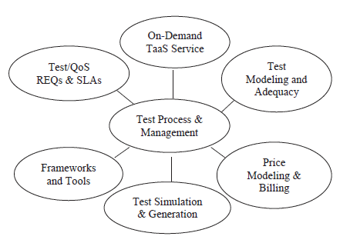

Slide 7
Cloud testing elements
Identifying relevant testing types
Understanding cloud characteristics and conducting a risk/challenge analysis
Setting up a cloud testing environment
Simulating real-world challenges by selecting the right testing strategy

Slide 8
Benefits of Cloud Testing
Dynamic availability of testing environment
Environment supplied to the testing teams very rarely match a customer environment on account of rapidly changing requirements, as a result of which it is very challenging for the companies to keep it up.
Cloud is the only answer to this problem whereby, users can easily replicate a customer environment and find defects early in the cycle.

Slide 9
Benefits of Cloud Testing
Low cost:
When companies invest in the infrastructure, the usual case of it is many of their servers are not utilized all the time.
As a result, they may have to incur additional expenses on license renewal.
Transitioning to cloud helps in this scenario as well, as users can commission appliances as and when they want, thereby saving huge costs for an organization.

Slide 10
Benefits of Cloud Testing
Easily customizable
With the use of cloud, it’s an easy task for organizations to emulate an end-user centric environment by customizing it as per the usage thereby, saving cost and time.
Test teams can easily perform load and performance testing scenarios in various permutations and combinations like – different OSes, runtime, browsers, configurations, etc.

Slide 11
Benefits of Cloud Testing
Scalability
This is one of the most attractive features of the cloud whereby the computing resources can be increased or decreased wherever it is necessary.
This is widely used in the situations where the business requirements keep altering frequently.

Slide 12
Cloud Testing Forms
Testing of the whole cloud: The cloud is viewed as a whole entity based on its features and testing is carried out based on that.
Testing within a cloud: This is the testing that is carried out inside the cloud by checking each of its internal features
Testing across the clouds: Based on the specifications, here the testing is carried out on the different type of clouds-like public, private and hybrid clouds.
SaaS testing in cloud: Functional and non-functional testing is performed based on requirements.

Slide 13
Cloud Testing Environments
A private or public environment where the quality of applications deployed in them needs to be validated.
A hybrid environment, where the quality of applications deployed in them needs to be validated.
A test environment which is cloud-based, where the quality of applications deployed in the cloud needs to be validated.

Slide 14
Types of Testing Performed in the Cloud
Functional Testing
Non-Functional Testing

Slide 15
Functional Testing
System Verification Testing: To ensures whether the various modules function correctly with one another, thus making sure that their behaviour is as expected.
Acceptance Testing: Here the cloud-based solution is handed over to the users to make sure it meets their expectations.
Interoperability Testing: Any application must have the flexibility to work without any issues not only on different platforms but it must also work seamlessly when moving from cloud infrastructure to another.

Slide 16
Non-Functional Testing
Availability Testing:
The cloud supervisor/vendor has to make sure that the cloud is available round the clock.
As there could be many mission-critical activities going on, the administrator has to make sure that there is no adverse impact to the consumers

Slide 17
Multi-Tenancy Testing: Here, multiple users use a cloud offering. Testing must be performed to ensure that there is sufficient security and access control of the data when multiple users are using a single instance.
Scalability Testing: Test to make sure that offering has the capability to provide scale up or scale down facilities as per the need.

Slide 18
Performance Testing: Verification of the response time needs to be done to ensure that everything is intact even when there is a lot of requests to be satisfied.
The network latency is also one of the critical factors to evaluate performance. Also, workload balancing needs to be done when there is a reduction in load, by decommissioning resources.
Thus load and stress testing are done in the cloud offering to make sure applications are performing optimally with increase/decrease in load and stress.

Slide 19
Security Testing: As everything is available anytime with Cloud, it’s essential to make sure that all user sensitive information has no unauthorized access and the privacy of users remains intact.
When maintaining the applications in the cloud, user data integrity must also be verified.

Slide 20
Disaster recovery Testing: The cloud has to be available at all times and if there are any kind of failures like network outages, breakdown due to extreme load, system failures, etc, measure how fast the failure is indicated and if any data loss occurs during this period.

Slide 21
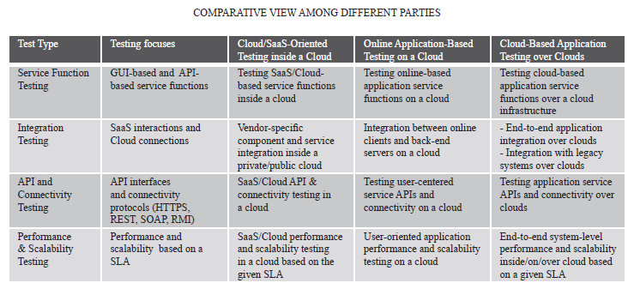

Slide 22
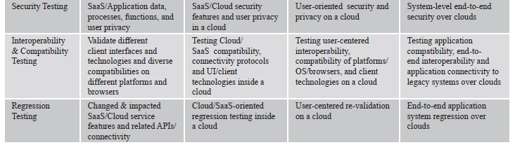

Slide 23
Cloud Testing Challenges
Challenge #1
Security is a primary issue for the businesses as currently there is still a lot of discussion and research going on in the industry to set up security standards.
User privacy protection, security standards on the cloud, security of applications running in the cloud, security testing techniques are some of the primary issues that need to be addressed in the cloud infrastructure.

Slide 24
Cloud Testing Challenges
Challenge #2
Another big challenge is the performance of an application in a cloud, specifically in private clouds. It will be shared across many users and hence could lead to delays as well.
Also in case of some maintenance or outage-related activities, the bandwidth may seem to be insufficient.

Slide 25
Cloud Testing Challenges
Challenge #3
Sometimes for testing purposes, we require certain configurations with respect to servers, storage or networking which may not be supported by the cloud provider.
This sometimes makes it difficult to emulate customer environments.

Slide 26
Cloud Testing Challenges
Challenge #4. Another commonly faced challenge is with respect to integration testing whereby the testers test the network, database, servers, etc.
In such situations, the tester will not have control over the underlying environment.
Secondly, the challenge is doubled when there has to be an interaction between these components because the tester will have to anticipate risks like crashes, network breakdown or servers going kaput.

Slide 27
Expectations from Cloud Testing
Need #1: Adequate test models and criteria To effectively support cloud testing, engineers need new adequate test models and criteria
Need #2: TaaS test processes and QoS standards Today’s commercial SaaS and clouds provide different types of Service Level Agreement (SLA) for users. However, both vendors and users need well-defned testing and quality assurance standards as a theoretic base to establish fair and sound service level agreements between them.

Slide 28
Need #3: Innovative test methods and solutions The new features and new requirements of cloud-based applications and SaaS bring some demands on new test methods and solutions
Need #4: Innovative dynamic test platforms and tools Cloud testing requires large scale real-time test loads in a scalable web-based distributed environment. This suggests the need of several test tools and solutions. One of them is a powerful test simulator, which provides large-scale web based test simulation and data generation in a cloud using virtual and physical computing resources.

Slide 29
Today, Cloud Computing has become one of those “big bangs” in the industry, organizations are now leaning towards adopting the cloud because of its flexibility, scalability and reduced costs.
Using the cloud for testing is immensely helping organizations to acquire the required tools, software licenses, infrastructures at a very low cost without having to set it up themselves and later worry about its maximum utilization.

Slide 30
Cloud and conventional methods of Computing (Testing Landscape)
Software Build Generation
Build Deployment
Data bed preparation
Functional Testing
Non functional Testing

Slide 31
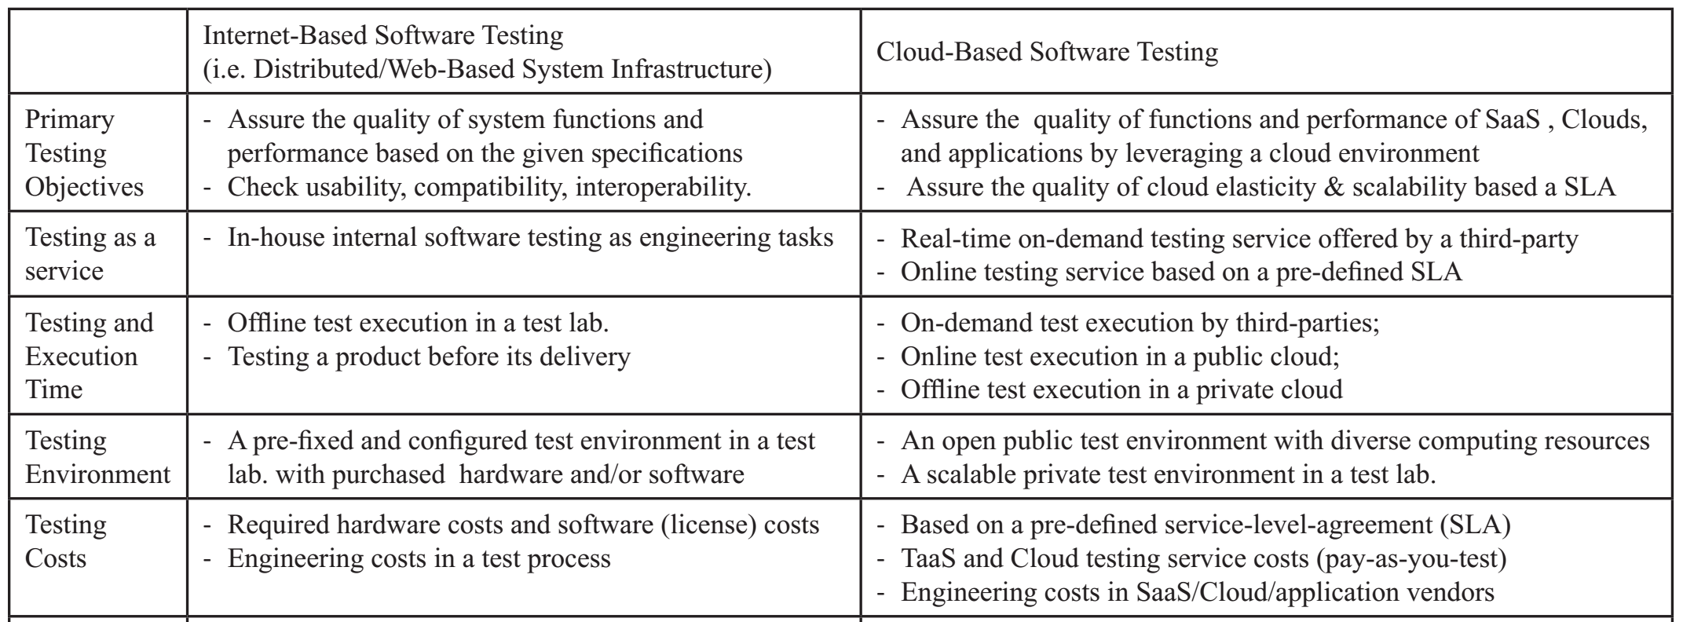

Slide 32
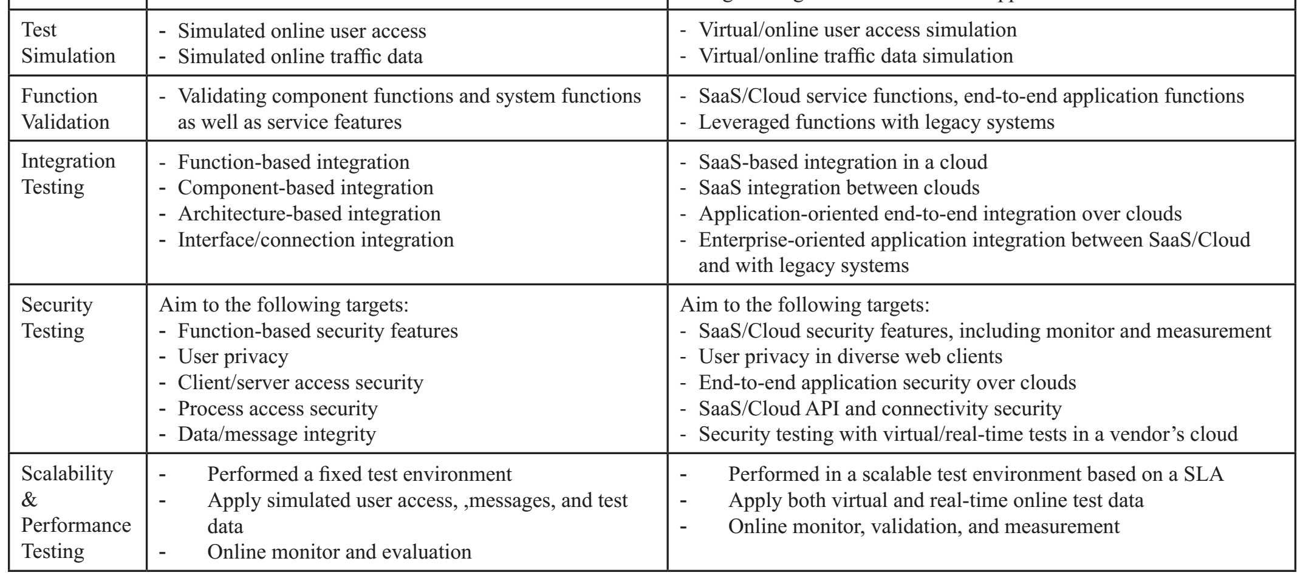

Slide 33
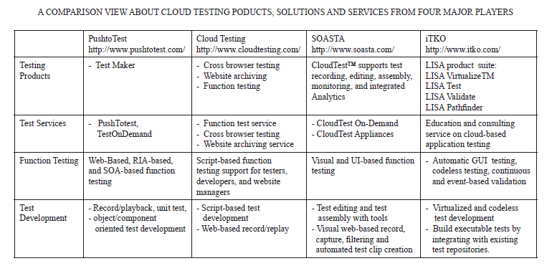

Slide 34
Cloud Testing Tools

Slide 35
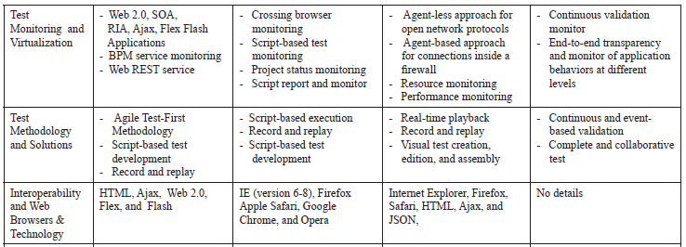

Slide 36
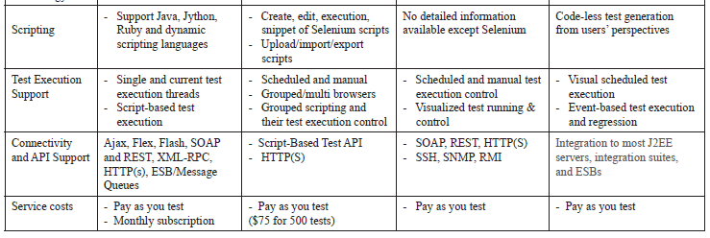

Slide 37
Bibiliography
https://www.techopedia.com/definition/26540/cloud-testing
http://www.softwaretestinghelp.com/getting-started-with-cloud-testing/

